Slide 1
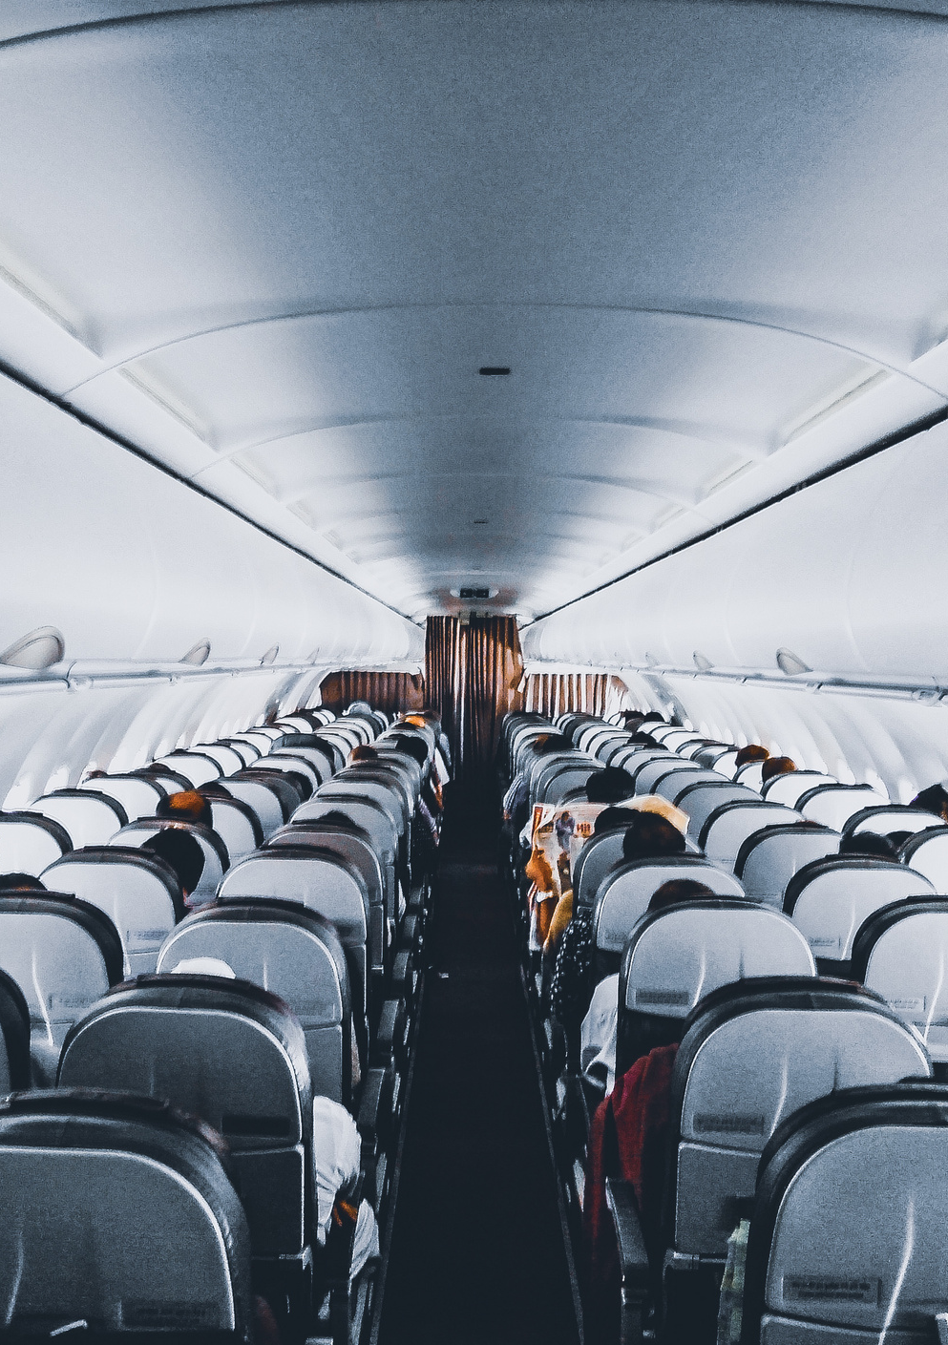
AIRLINE RESERVATION SYSTEM

Slide 2


GUIDEED BY
Dr. Ehab Emam
Eng. Nouran Waleed
PROJECT BY
Kareem Yousry 18102746
Mohamed Tarek 18100026

Slide 3

INTRODUCTION OF AIRLINE RESERVATION SYSTEM
TECHNOLOGIES TO USED
CONTENTS

Slide 4


Introduction of airline reservation system
Airline reservation system is a computerized system
Enhancing the relationship between customers and airline agencies
Convenient for the customers to book the flights
Allow the employee to access the database and allow new employee to be added by admin

Slide 5
System Requirements
SOFTWARE REQUIREMENTS
HARDWARE REQUIREMENTS
Operating System: Windows
User Interface: Netbeans
Programming Language: JAVA
Database: MYSQL
Server used: XAMPP
Processor: any
Hard Disk: 10 MB minimum
RAM: 256 MB or more
Any Screen

Slide 6

JAVA
Java is a programming language and a platform.
Java is a high level, robust, secured and object-oriented programming language.
PLATFORM
Any hardware or software environment in which a program runs, is known as platform.
Since Java has its own runtime environment (JRE) and API, it is called platform.

Slide 7
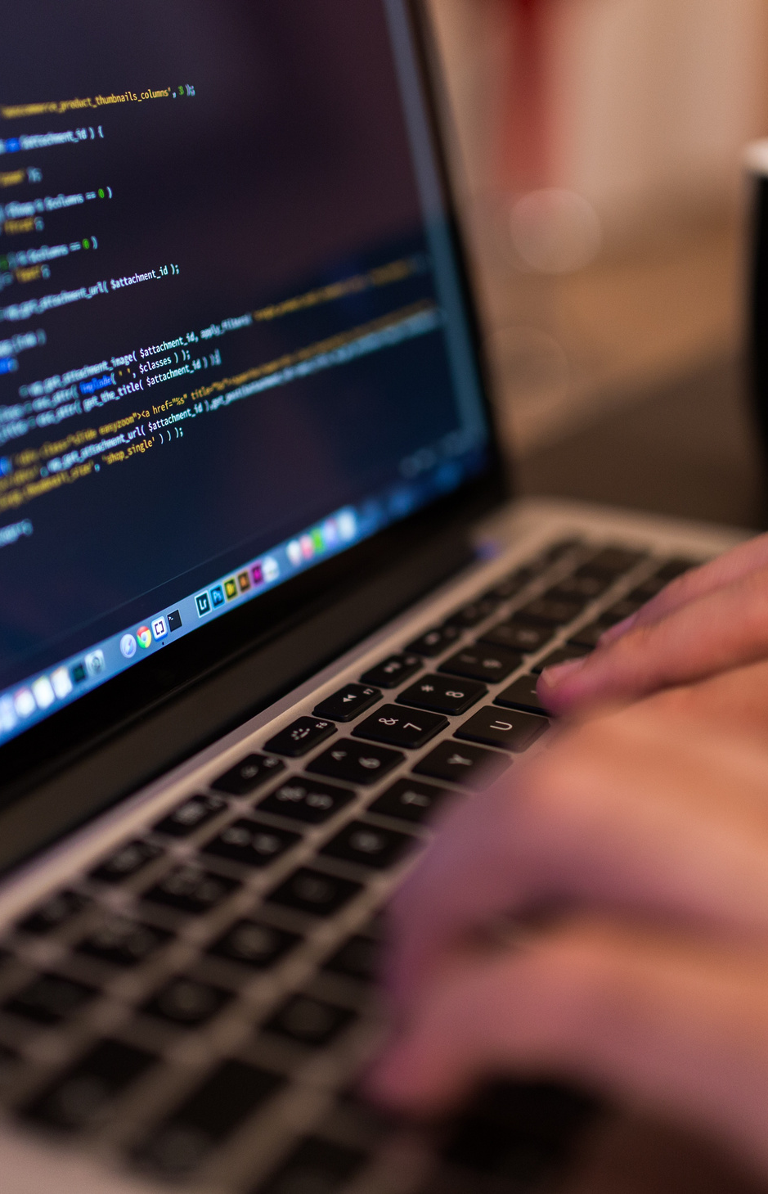
WHAT IS JDBC?
JDBC is a java TM API for executing SQL statements.
It consists of a set of classes and interfaces written in the java programming language that makes it easy to send SQL statements to virtually any relational databases.
JDBC (Java Database Connectivity) front end is in java and back end is in MYSQL.

Slide 8


SYSTEM FUNCTIO-NALITY
USER FUNCTIONALITY
ADMINISTRATOR FUNCTIONALITY

Slide 9
ADMINIS-TRATOR FUNCTIO-NALITY
Login
Add customer information
Update customer information
Customer record
Add flight information
Book ticket
Cancellation of reservation
Ticket report
User creation

Slide 10
Customer FUNCTIO-NALITY
Login
Sign up
Update customer information
Search Flight
Book ticket
Cancellation of reservation

Slide 11

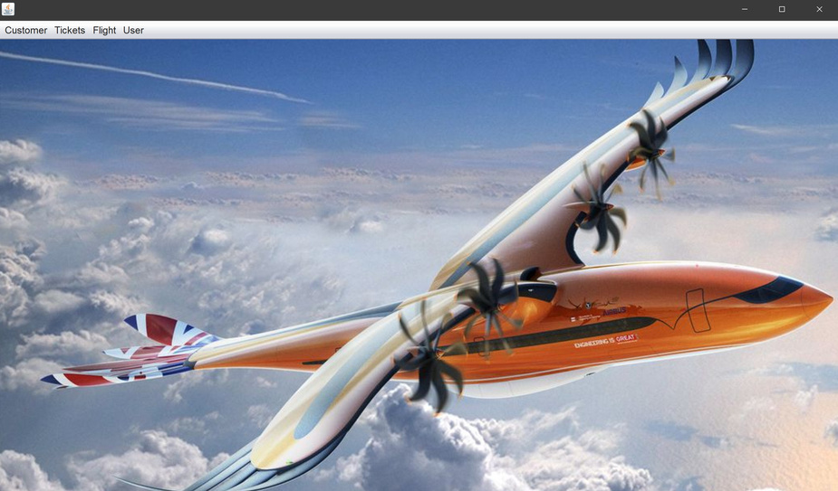
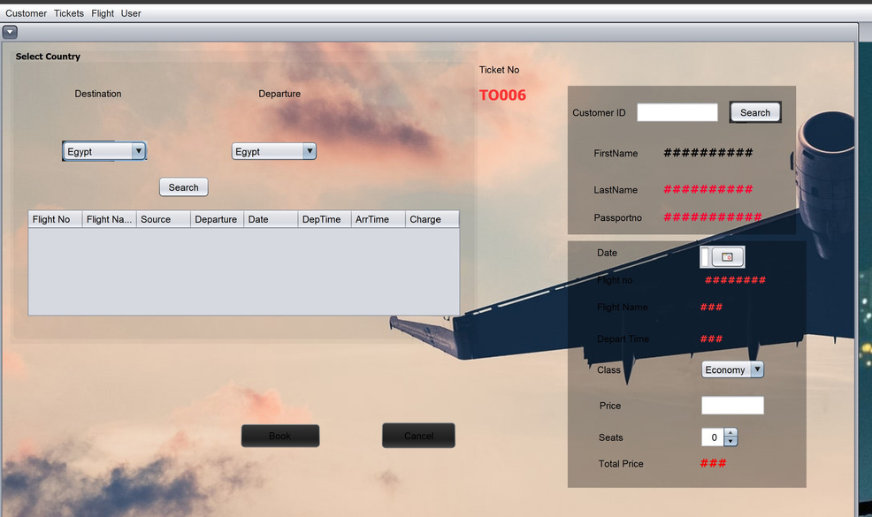
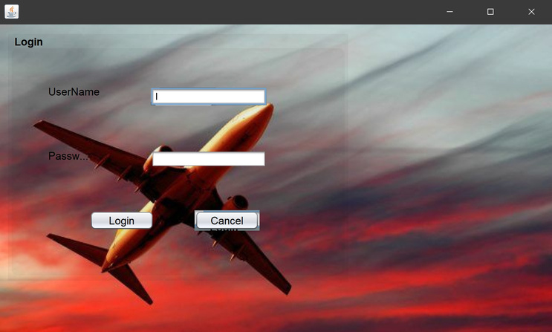
Process
MAIN PAGE
TICKET RESERVATION PAGE
LOGIN PAGE

Slide 12
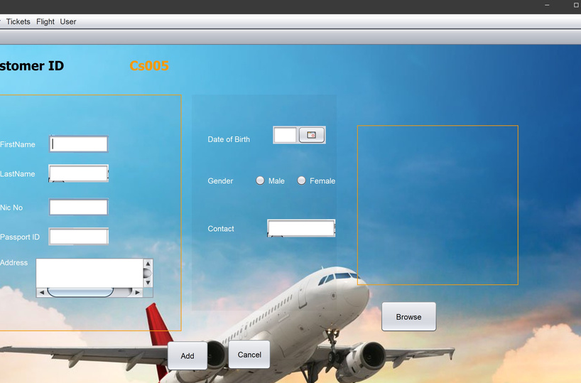
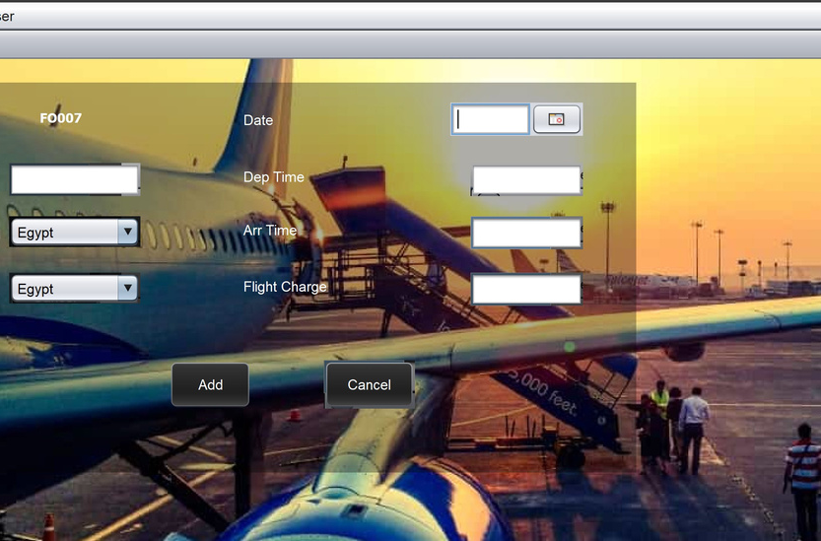
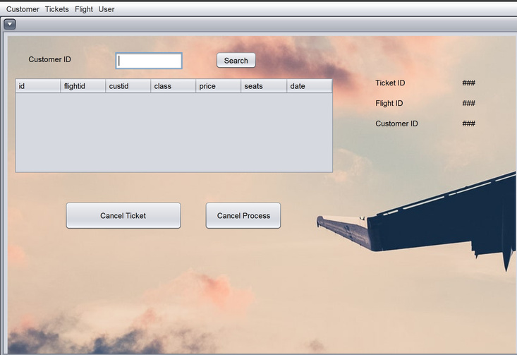
Process
ADD CUSTOMER PAGE
ADD FLIGHT PAGE
CANCEL TICKET PAGE

Slide 13
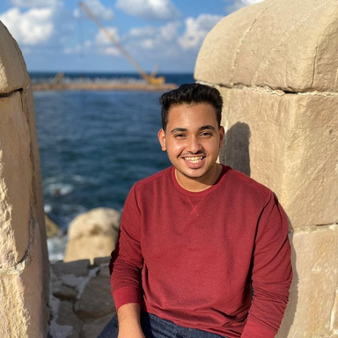
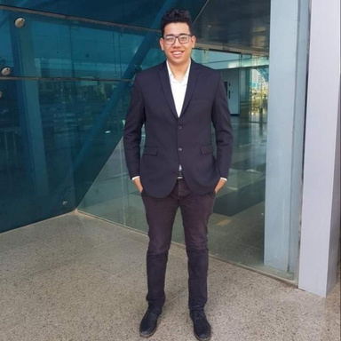
THE TEAM
KAREEM YOUSRY
MOHAMED TAREK
18102746
18100026

